Slide 1
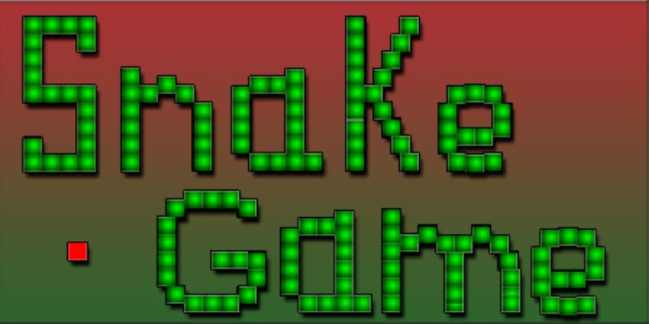

Slide 2
Verilog Project on Snake Game
Jessica Qiu
Jueun Kang
Xiaoxiao Yang
Panqi Gu

Slide 3
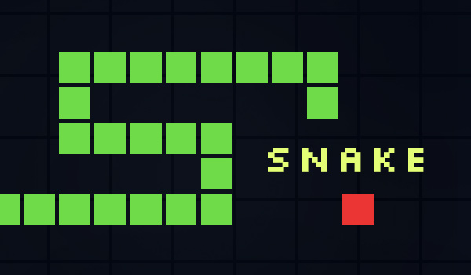
Goal/Motivation
We are designing a Snake game using Verilog on an FPGA, displayed on a VGA monitor
Goal is to demonstrate real-time game rendering, user input handling, and system design.
Helps us understand how to implement game logic in FPGA design, digital logic, and embedded systems development.
Real life Ex: This project could be used to teach students about digital logic in a fun way!
Notes:
Xiaoxiao yang

Slide 4
Short Functionality
The Snake game runs on a FPGA board, displaying on the VGA monitor.
The user can control the snake’s movement using the buttons on the FPGA board. (up, down, right, left)
The snake grows by eating apples and avoids colliding with the walls or itself with random apple generation on the map.
The game will track the score in real life time on the FPGA board.
Notes:
Xiaoxiao yang

Slide 5
Short Specification
Requirements:
Create a snake game using an FPGA and displaying the game output on VGA monitor.
Use Verilog modules for game design logic such as game controls and VGA rendering
Gameplay elements
A snake that grows when it eats an apple (randomized)
Collision detection for the wall and snake itself
Score tracking/display
Constraints
Limited FPGA resources like memory and logic elements
VGA timing and synchronization
Minimal delay inputs from the FPGA buttons to the game
Ensure smoothness of the snake movement
Notes:
Jessica Qiu
Short Specification – one slide max recapping the specification of the design. What were the requirements? Constraints?

Slide 6
Detailed Block Diagram
Clock divider
Controlling the snake movement with FPGA buttons
Making sure that it is the right buttons
If wrong buttons, it won’t process through
Top Module
for snake
Snake Movement and Controls
Generating screen display like the borders, snake, apple, etc with RBG outputs
Generates hysync and vsync with clock divider
VGA
Update snake length
Update random apple position
Game difficulty level (harder = faster snake)
Check if snake collision
Update if the game is paused or restarted or game over
Update scoring
General Game Mechanics
Notes:
Jueun Kang
5. Detailed Block Diagrams – provide the real block diagrams for your design.
Top Module
Main module that integrates all the module
Combines the inputs (e.g., buttons) and processes them through the appropriate submodules.
Controls the interactions between the Snake Movement and Controls, VGA, and Game Mechanics.
Manages the game's flow, including updates to the snake's position, apple, score, and other game states.
Clock divider
Converts the FPGA’s high-frequency clock to slower clock signals suitable for the game.
Divides the clock for generating VGA signals
Snake movement and controls
Ensures the input is valid (e.g., the snake cannot reverse direction).
Updates the snake’s position based on valid button presses.
Sends the updated position to the VGA for display and to the Game Mechanics for collision checks.
VGA
Generates RGB signals and synchronization signals (hysync and vsync) for the screen display.
Hsync: Handles the horizontal position for drawing individual rows.
The screen is divided into horizontal lines (or rows).
Each row of pixels is drawn from left to right.
At the end of each row, the HSYNC pulse tells the display to move the drawing position back to the left edge of the next row.
Vsync: Handles the vertical position for drawing the entire frame.
When all the rows in the frame are drawn, a VSYNC pulse tells the display to move back to the top of the screen and start a new frame.
Displays the game elements, including the snake, the apple, and the game borders.
Receives updates from the Snake Movement and Controls and Game Mechanics to render the screen.
General Game Mechanics
Just read off slide

Slide 7
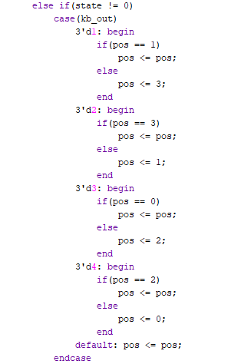
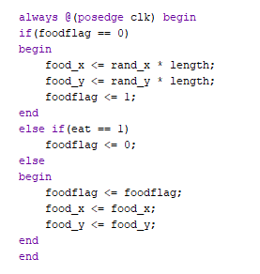
Code Snippet
Food Placement Logic
Collision Avoidance
Notes:
Panqi Gu

Slide 8
Successes
Users are able to choose different difficulty level of the game. The snake in the hardest level move fastest.
The snake can eat apple and get longer
The game can pause and restart.
Notes:
Jueun Kang
Successes – discuss how your project was successful and why.
Users are able to choose different difficulty level of the game. The snake in the hardest level move fastest.
Why: The difficulty level in the Snake game is managed by the diff parameter, which is set in the always @(posedge clk) block. Here's how it works:
The state variable controls the game state. When the state is 0 (the initial state), the difficulty is selected based on the value of key_out. The key_out values correspond to different difficulty levels:
3'd1 sets the difficulty to "hard" (diff <= 2).
3'd5 sets the difficulty to "medium" (diff <= 1).
3'd3 sets the difficulty to "easy" (diff <= 0).
After the difficulty is selected, the state changes to 1 (waiting state), and then it changes to 2 (the game state). In state 2, the difficulty level determines the snake's speed:
2'd0 (easy): speed <= 24'd15000000.
2'd1 (medium): speed <= 24'd10000000.
2'd2 (hard): speed <= 24'd5000000.
The speed value controls the snake's movement speed. The cnt_js counter increments until it reaches the speed value, and when it does, the snake's body refreshes (via DIR <= 1).
Nutshell: Different Difficulty Levels: The game has three selectable difficulty levels: easy, medium, and hard. The level of difficulty is determined by the diff register. → Snake Speed and Game Challenge: As the difficulty level increases, the snake's speed also increases, making the game more challenging. The speed variable controls the time interval between snake movement updates, with shorter intervals corresponding to higher speeds. The speed value is adjusted based on the diff setting. (so if it’s easy difficulty, the snake goes slower)
The snake can eat apple and get longer
Why:
Food Collision Detection: The condition if((food_x == h_all[9:0]) && (food_y == v_all[9:0])&&(state == 2)) checks if the head of the snake (represented by h_all[9:0] and v_all[9:0]) is at the same position as the food (represented by food_x and food_y). This means that the snake's head has "eaten" the apple.
The snake's length (num) increases when it eats the food. This is handled after detecting the collision with the food. We also made sure to handle that the snake can only grow one body at a time instead of two by having a register keeping in check and ensures the snake grow one at a time when it eats the apple in a conditional statement.
Nutshell: The snake eats the apple when its head coordinates match the food coordinates → After eating the food, the snake grows by one segment (unless the bug is present, which is addressed by the cs logic). → The game updates the snake’s body length, and the food respawns in a new location.
The game can pause and restart
Why:
The state register is used to track the current state of the game (whether the game is running, paused, or over). It’s assigned values like:
state == 0: Game is in a paused state.
state == 1: Game is running.
state == 2: Game over or other specific states like waiting for a restart.
Pausing: The game can pause if a button or input signal is received, which triggers a change in the state variable to state == 0. This could be the result of pressing a specific button or key, which halts the game mechanics and freezes the snake's movement and any other game behavior.
Resume: The player can resume the game by triggering a transition back to state == 1 (game running). This is done by pressing the pause button again or a different input signal.
Restart: The restart functionality is similar to the pause feature. If a game over occurs or the player wants to restart, pressing a button might reset the state to state == 1 and reset other game variables like the snake's position and score.
Nutshell: Pause: The game can be paused by setting state == 0, which stops all game mechanics, like movement and scoring. → Unpause by pressing the same button again → Restart: The game can be restarted by resetting game variables (snake position, score, etc.) and transitioning state to state == 1, allowing the game to start fresh. → The button plays a role in toggling between the game states.

Slide 9
Failures
The scoring is messed up. Whenever the snake eats the apple, it would not increment the scoring and not showing a proper number.
The border of the game is a bit too big (not visible) so the snake head will disappear a bit before crashing into the wall.
We tried coding the controls of ps2 keyboard but it did not work.
Notes:
Jessica Qiu
Failures – discuss how your project did not work out as you planned. Provide examples of what you would do differently.
The scoring is messed up. Whenever the snake eats the apple, it would not increment the scoring and not showing a proper number.
Ex:
We think that it could be some sort of incorrect display mapping issue. The timing seems right as it does update properly whenever the snake eats the apple. The mapping of num values to the 7-segment display (via seg_data0) might not correctly correspond to the actual digits being passed. We can confirm that the correct values are being assigned to seg_data0. We can check that each case in the num to seg_data0 mapping corresponds to the right 7-segment display encoding for digits. It’s possible that num is not being calculated correctly, and thus the display logic does not show the right numbers.
The border of the game is a bit too big so the snake head will disappear a bit before crashing into the wall.
Ex: We can try adjusting the border parameters and experiment/trial and error it.
Horizontal Border: If the border is too large, adjust the hbp (horizontal back porch) and hfp (horizontal front porch) parameters to shrink the border. The hbp and hfp values define where the visible area starts and ends horizontally. We can decrease the values slightly to increase the visible area.
Vertical Border: Similarly, adjust the vbp (vertical back porch) and vfp (vertical front porch) parameters to shrink the top and bottom margins of the screen, ensuring the visible area is larger and the snake head is more likely to be seen before crashing into the wall.
We tried coding the controls of ps2 keyboard but it did not work.
Ex:
We aren’t really sure why it’s not detecting the key codes we coded in our verilog code. The key codes does correspond to the HP ps2 keyboard. It could be a timing issue with the registers PS2Cf and PS2Df. The flags PS2Cf and PS2Df are used to detect the edges of the clock and data signals. If these flags are not properly synchronizing with the incoming PS2 data stream, the key presses might not be captured correctly. Maybe we can ensure that PS2Cf and PS2Df are being updated correctly in relation to the clock cycles. If the clock isn't stable or isn't properly timed, these flags might not be set at the correct moments, leading to missed edges.

Slide 10
Thank You

